Slide 1
Scripting ODTK through its COM interface
Conrad Schiff/595.0
Ver 1.2
Last updated: 2/25/09

Slide 2
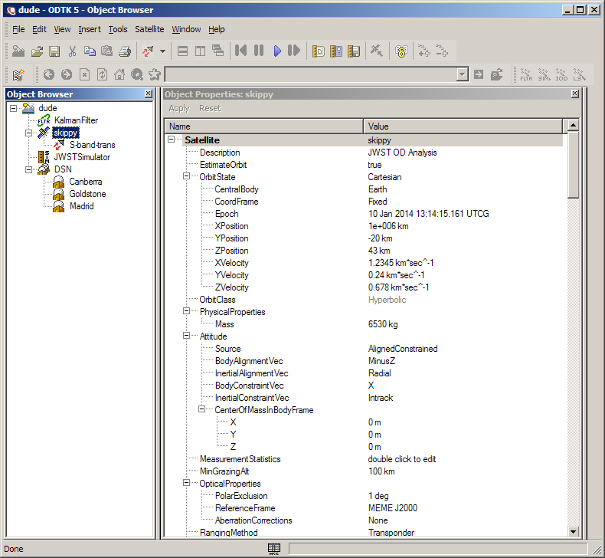
Introduction
At first glance ODTK looks like the rest of STK
A second glance can change that point of view
  Each object has lots of attributes
  Nomenclature can be quite different
    InstantManeuvers vs Impulsive Maneuvers
Use of ODTK is made easier by its
  object oriented hierarchy
  scripting via COM interface
Any scripting language with COM functionality will work (VB Script, VBA, Perl, Python, C++, C#,…)
All examples here are done in Perl
2/25/09
ODTK & COM

Slide 3
ODTK Object Hierarchy
Scenario
Filter
GPS
Constellation
Satellite
Simulator
Smoother
Tracking
System
GPS
Satellite
Antenna
Facility
Emitter
Antenna
Emitter
GPS
Receiver
GPS
Receiver
IOD
Transponder
Least
Squares
Retro
Reflector
2/25/09
Transponder
ODTK & COM

Slide 4
Opening ODTK with Perl
Place the following line at the top of your Perl script
  use Win32::OLE qw(in valof with OVERLOAD);
    in –
    with –
    valof –
    OVERLOAD -
Create a Perl OLE ODTK server object (a pointer to the server)
  $odapp = Win32::OLE->new(“ODTK5.Application”,sub{$_[0]->Quit})
Set the application attributes to have a ODTK GUI that is visible and which you can control (debug)
  $odapp->LoadPersonality(“ODTK”)
  $odapp->{Visible} = 1
  $odapp->{UserControl} = 1
Now create a pointer to the ODTK GUI
  $ODTK = $odapp->personality
2/25/09
ODTK & COM

Slide 5
Getting Started and Creating Objects
Now create a scenario
  $scen = $ODTK->CreateObj($ODTK, “Scenario”, “<name>”)
Now create objects within the scenario
  $<yyy> = $ODTK->CreateObj($scen, “<X>”, “<name>”)
  <yyy> and <name> are any strings desired, <X> is fixed
  Example
$<yyy> <X> <name>
$fil Filter Kalman
$gps GPSConstellation lots_of_stuff
$sc Satellite skippy
$sim Simulator faker
$sm Smoother baby_bottom_smooth
$trak TrackingSystem DSN
2/25/09
ODTK & COM

Slide 6
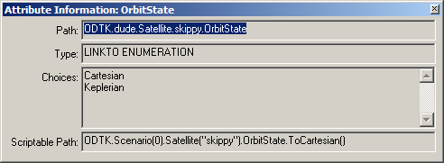
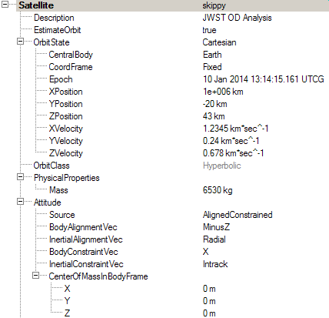
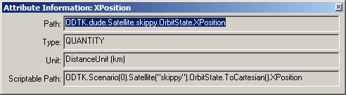
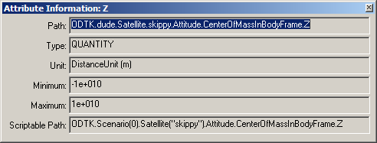
Setting Object Parameters (1/4)
Object attributes tend to be grouped in hierarchies
  Satellite object owns an OrbitState
  OrbitState owns an attribute and a group of ‘sub-attributes’
ODTK has an internal way of referencing the attributes, which can be found by right mouse clicking on the attribute in question
2/25/09
ODTK & COM

Slide 7
Setting Object Parameters (2/4)
Each object can have one or more of the following 14 types of attributes:
  BOOL
  DATE
  INT
  LINKTO
  LINKTO ENUMERATION
  LINKTOOBJ ENUMERATION
  LIST
  QUANTITY
  REAL
  SCOPE
  SET
  SET ENUMERATION
  SETLINKTOOBJ
  STRING
  STRING ENUMERATION
Rarely obvious from the GUI what type you are dealing with – particularly confusing is LIST, SET, SET ENUMERATION, and SETLINKTOOBJ
Often objects look like and are labeled as ‘List’ without being of the type LIST
2/25/09
ODTK & COM

Slide 8
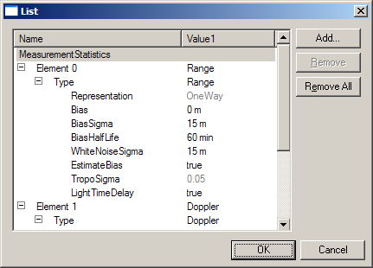
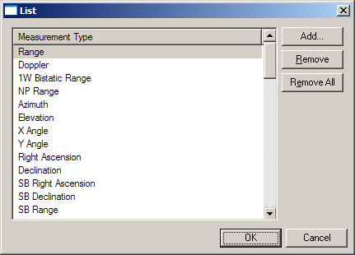
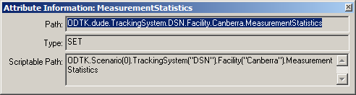
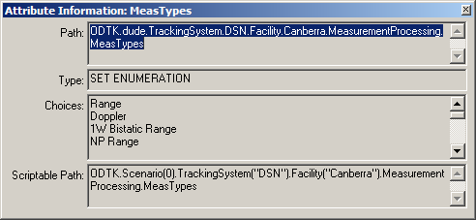
Setting Object Parameters (3/4)
Consider the following parameters from a Facility object
A collection of measurement A collection of measurement
statistics parameters types available
2/25/09
ODTK & COM
Neither is of type LIST!

Slide 9
Setting Object Parameters (4/4)
Certain object parameters are taken as whole and are treated as special cases
  Facility position
  Satellite orbit state
To properly set these a group of parameters must be assigned values to a local variable in Perl and the collection sent back at once if coordinate conversions are required (i.e. automatic conversion of the state from Cartesian to Keplerian)
Since the base state is Cartesian, this caveat can be ignored if Cartesian elements are being set and the frame is known beforehand
2/25/09
ODTK & COM

Slide 10
Setting Object Attributes in Perl
The typical way to do things in Perl is to first create a pointer to an object
Additional pointers to attributes and sub-attributes simplifies the script
  Example: Set a spacecraft’s description and orbital elements
  $sc = $ODTK->CreateObj($scen,”Satellite”,”skippy”);
  $sc->{Description} = “Spacecraft used for routine OD analysis”;
  $sc->{OrbitState} = “Keplerian”;
  $sc->OrbitState->{CentralBody} = “Earth”;
Note the use of the -> for referencing one level down and the use of {} to surround the parameter being assigned a value
2/25/09
ODTK & COM

Slide 11
Setting Type BOOL
The type BOOL is a Boolean true/false choice
The string used must be either “true” or “false”
A typical assignment example would look like
  $sc = $ODTK->CreateObj($scen,”Satellite”,”JWST”);
  $sc->ForceModel->Drag->{EstimateDensity} = “true”;
  or
  $sc->ForceModel->Drag->{EstimateDensity} = “false”;
2/25/09
ODTK & COM

Slide 12
Setting Type DATE
The type DATE requires two assignments:
  A string with a date format of “dd Mmm yyyy hh:mm:ss.xxx”
  A string with the time system “UTCG”
Since there are two parameters, a direct assingment with the ‘=‘ doesn’t work and one must use the Set command (no need for {} when Set is used)
A typical assignment looks like
  $sc = $ODTK->CreateObj($scen,”Satellite”,”JWST”);
  $sc->OrbitState->Epoch ->Set("10 Jan 2014 13:14:15.161","UTCG");
2/25/09
ODTK & COM

Slide 13
Setting Type INT
Typical assignment looks like
  $sc->MeasurementProcessing->{TrackingID} = 5067;
  or
  $sc->MeasurementProcessing->{TrackingID} = “5067”;
  (i.e. with or without quotes)
  also of interest
  $sc->ForceModel->Gravity->{Degree} = 50;
2/25/09
ODTK & COM

Slide 14
Setting Type LINKTO
The LINKTO type is used when doing a validated assignment.
A validated means that the value on the right-hand side is compared to an acceptable list and it is rejected if no match is found.
This is mostly used for setting file paths and file names for input files.
Validated assignment occurs most frequently when setting modeling information like where to find the geopotential file
Typical assignment looks like
  $scen = $ODTK->CreateObj($ODTK,”Scenario”,”JWST Scenario”);
  $scen->EarthDefinition->{GravityModel} =
  "c:\\Program Files\\AGI\\ODTK 5\\STKData\\CentralBodies\\Earth\\EGM96.grv";
  Note the need in Perl to use the double slash for file paths
2/25/09
ODTK & COM

Slide 15

Setting Type LINKTO ENUMERATION
The LINKTO ENUMERATION is used to represent in scripting what is presented in a drop down box in the GUI
As an example, the orbit state can be set as Cartesian or Keplerian by
$sc->{OrbitState} = “Cartesian”;
or
$sc->{OrbitState} = “Keplerian”;
Functionally identical to the STRING ENUMERATION type
Specific choices of an enumeration can always be found be querying the attribute information
2/25/09
ODTK & COM

Slide 16
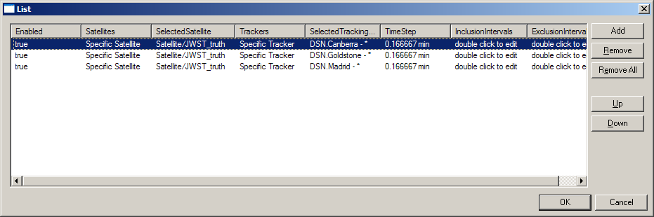
Setting Type LINKTOOBJ ENUMERATION
LINKTOOBJ ENUMERATION is similar to SETLINKTOOBJ in that the allowed choices must be instantiated ODTK objects
The place it is encountered in current scripting is setting the simulator’s custom tracking intervals
The magic formula for telling the simulator to choose a specific s/c is:
  $sched->Item(0)->{Satellites} = "Specific Satellite";
  $sched->Item(0)->{SelectedSatellite}->Assign($sc_truth->Satellite);
2/25/09
ODTK & COM

Slide 17
Setting Type LIST
The type LIST comes with commands to dynamically create or delete entries as well as assign to them
  clear
  Item(i)
  NewElem
  push_back($ne)
  push_front($ne)
  RemoveAt(i)
  where $ne is a pointer to a new element and i is an integer index in the list (list starts at 0)
This is also a good example of setting a pointer to an attribute of an object instead of the object itself
$scen = $ODTK->CreateObj($ODTK,”Scenario”,”JWST Analysis”);
$ms_list = $scen->Measurements->Files;
$ms_list ->clear; #clear the list
$ne = $ms_list->NewElem; #create a new element pointer
for($i=0;$i<3;$i++){$ms_list->push_back($ne)} #create 3 entries
$ms_list->Item(0)->{filename} = “c:\\...”; #set the filename for entry 1
$ms_list->RemoveAt(1); #remove item 1
Note that the individual filenames are validated assignments
2/25/09
ODTK & COM

Slide 18
Setting Type QUANTITY
The type QUANTITY is conceptually similar to DATE in that two parameters must be specified:
  values
  units
Like the use of DATE, QUANTITY requires the use of the Set command
$sc->OrbitState->XPosition ->Set(1000000,"km");
$sc->OrbitState->YPosition ->Set(-20, "km");
$sc->OrbitState->ZPosition ->Set(43, "km");
$sc->OrbitState->XVelocity ->Set(1.2345, "km*sec^-1");
$sc->OrbitState->YVelocity ->Set(0.24, "km*sec^-1");
$sc->OrbitState->ZVelocity ->Set(0.678, "km*sec^-1");
$sc->PhysicalProperties->Mass ->Set(6530, "kg");
The format of the units can be found by looking at the choices listed in the GUI.
2/25/09
ODTK & COM

Slide 19
Setting Type REAL
Setting type REAL looks just like type INT except it is much rarer (many REAL inputs are actually of type QUANTITY)
The parameters that come up often are the eccentricity, coefficients of drag & reflectivity, and the parameters associated with residual (e.g sigma) editing on the spacecraft,
$sc->MeasurementProcessing->ResidualEditing->NominalSigma = 3.5;
Spacecraft orbit state elements are set as a special case (discussed earlier) and the assignment would be
  $scen->OrbitState->ToKeplerian->{Eccentricity} = 0.051;
Note the ‘extra’ ToKeplerian in the specification
2/25/09
ODTK & COM

Slide 20
Setting Type SCOPE
Type SCOPE is a static type that cannot be set
Any parameter labeled with type SCOPE is simply a header for a group of related sub parameters
Example: $filter->Restart
2/25/09
ODTK & COM

Slide 21

Setting Type Set
The type SET is used for a list of unique objects – duplications will be rejected
Available commands are clear, erase($i), InsertByName(<obj_name>), RemoveByName(<obj_name>) or is it Insert and Remove?
The typical application is used in setting up the Measurement Statistics at Facilities (ground stations)
$ts = $ODTK->CreateObj($scen,”TrackingSystem”,”DSN”);
$gs = $ODTK->CreateObj($ts,”Facility”,”Canberra”);
$meas_lst = $gs->MeasurementStatistics;
$meas_lst ->Erase($meas_lst->Item(3)); #erase azimuth
$meas_lst ->Erase($meas_lst->Item(2)); #erase elevation
$range = $meas_lst->Item(0);
$range_rate = $meas_lst->Item(1);
$range->Type->Bias ->Set($gs_parms->{"Range Bias"},"m");
Filter – “DSN.Canberra”
Simulator – “DSN.Canberra - *”
2/25/09
ODTK & COM

Slide 22
Setting Type SET ENUMERATION
The type SET ENUMERATION is used when setting to a internally pre-defined list of choices (i.e. these are things specified by ODTK with no user intervention) which cannot be duplicated in the list
Most attribute paths include:
  Satellite->ForceModel->Gravity->ThirdBodies->Planets
  Satellite->ForceModel->SolarPressure->EclipsingBodies
  Satellite->MeasurementProcessing->MeasTypes
Examples
$sc->ForceModel->Gravity->ThirdBodies->Planets->Insert(‘Moon’);
$sc->ForceModel->SolarPressure->Insert(‘Moon’);
$meas_types = $filter->MeasTypes;
$meas_types->clear
$meas_types->Insert(“Range”);
$meas_types->Insert(“Doppler”);
Available commands are clear, Choices, Erase(<obj name>), Insert(<obj name>)
2/25/09
ODTK & COM

Slide 23
Setting SETLINKTOOBJ
The SETLINKTOOBJ is used to add an existing object to a ‘list’
The most useful examples come from adding Satellite and Facility object to the list of OD participants in the filter
Example
$sc = $ODTK->CreateObj($scen,”Satellite”,”my_sc”);
$filter = $ODTK->CreateObj($scen,”Filter”,”my_filter”);
$ts = $ODTK->CreateObj($scen,”TrackingSystem”,”DSN”);
$can = $ODTK->CreateObj($ts,”Facility”,”Canberra”);
$em = $ODTK->CreateObj($can,”Emittee”,”Emittee”);
$filter->SatelliteList->Insert(“my_sc”);
$filter->SatelliteList->Insert($sc);
$filter->TrackerList->Insert(“DSN.Canberra”);
$filter->EmitterList->Insert(“DSN.Canberra.Emmtter1”);
Available commands are clear, Choices, Erase(<obj>), Insert(<obj>)
2/25/09
ODTK & COM

Slide 24
Set Type STRING
This type is similar to the LINKTO type with string input, except no validation occurs
Example
$sc->{Description} = “This spacecraft is being used for Monte Carlo OD”;
2/25/09
ODTK & COM

Slide 25
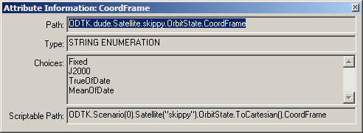
Set STRING ENUMERATION
The type STRING ENUMERATION is commonly used to set in script what would be presented in a drop down box in the GUI
Example
$sc->OrbitState->CoordFrame = “J2000”;
where the string has to match what is on the drop down menu
Specific choices of an enumeration can always be found be querying the attribute information
2/25/09
ODTK & COM

Slide 26
Special Case: Maneuver List
The following snippet shows how to read in a list of delta-Vs, dynamically construct a maneuver list, and set the parameters appropriately
$input_man_file = "c:\\CSchiff\\Development\\Perl\\ForODTK_Inertial_MU_MS060601_07_ST080123_C222_11_OLV_070_YZ_CU_4Deg_OD.txt";
open(man_data,$input_man_file) || die("Can't find the input maneuver file");
@raw_data = <man_data>;
my $manList = $sc->ForceModel->InstantManeuvers;
my $num_man = @raw_data;
my $man;
for($i = 0; $i < $num_man - 1; $i++)
{
($date,$man_name,$dx,$dy,$dz,$huh) = split(/\,/,$raw_data[$i]);
$manList ->push_back($manList->Choices(3));
$man = $manList->Item($i);
$man->Name->{Value} = $man_name;
$man->{Frame} = "Inertial";
$man->DeltaV->{DeltaVX} = $dx;
$man->DeltaV->{DeltaVY} = $dy;
$man->DeltaV->{DeltaVZ} = $dz;
$man->Epoch ->Set($date,"UTCG");
}
2/25/09
ODTK & COM

